Slide 1



UV Robot Design Challenge
IIT DELHI
Notes:
Shantnav: Hello everyone. It is a delight to connect with all of you. It is unfortunate how the Corona Virus has spread across the globe and disrupted our lives to such an extent. Nevertheless, it is heart-warming to see how humanity has come together to fight this novel virus on multiple fronts.

Slide 2

The Team
Dhruv Talwar
Prof Sunil Jha
Aashrith
Shantnav Agarwal (Team Leader)
Rohan Yuttham
Gunsagar Singh
Mukhar Jain
Neelabh Madan
Tanmay Goyal
Notes:
First, let me introduce you to the team. Prof Jha familiarised us to the competition and has guided us by providing numerous valuable insights that allowed us to make a competent design for the robot.
Dhruv and Tanmay worked on the development of the android application and the simulation of the robots while Rohan and Aashrith designed the Chassis and the drive system for the robot. Design decisions related to UV lights were analysed and finalised by Mukhar and Gunsagar with Neelabh worked on integrating a novel machine learning based voice enabled safety system. I am Shantnav. I led this awesome team collaborating across various verticals such as simulations, UV lights and the overall functioning of the robot.
I am now very excited to talk about the device we have created that can allow people to return to their offices and work in a safe and germ free environment.

Slide 3
Outline of presentation
Modern Design
Integration of UV lamps
Powerful Drive System
Light Weight Aluminium Frame
Energy consumption & Battery Life Estimate
Intuitive User Interface
Reliable – Open source Backend
Notes:
Shantnav: We shall start by talking about the design of our robot that will make it look right at home in most modern workplaces. After that, we shall talk about the configuration of UV lamps and how we made design decisions regarding this. We shall then introduce the drive system and the light weight yet strong Aluminium frame of the robot ensuring it’s long life and reliability. Disinfection is an energy intensive process. In our design, we ensured that the robot is able to sanitise a large area by choosing a battery with a large capacity. At the same time we doubled down on safety and reliability by choosing a battery chemistry that is extremely safe.
All functions and features of our product can be controlled by an android application making it’s operation extremely easy and user intuitive
In the backend all technologies used by us our completely open source and have been tested by the community of robotics globally. These software stacks are very reliable and ensure a glitch free experience for the end user!

Slide 4
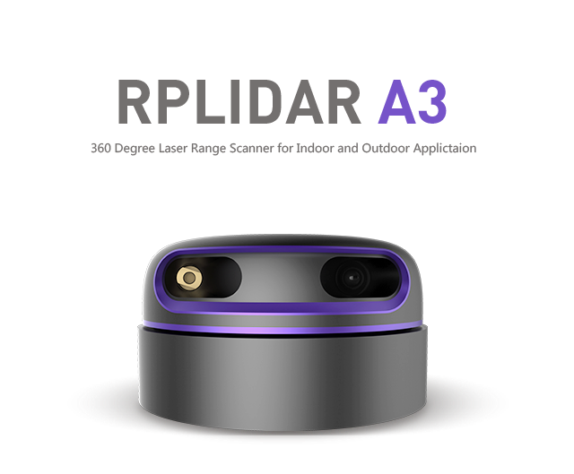
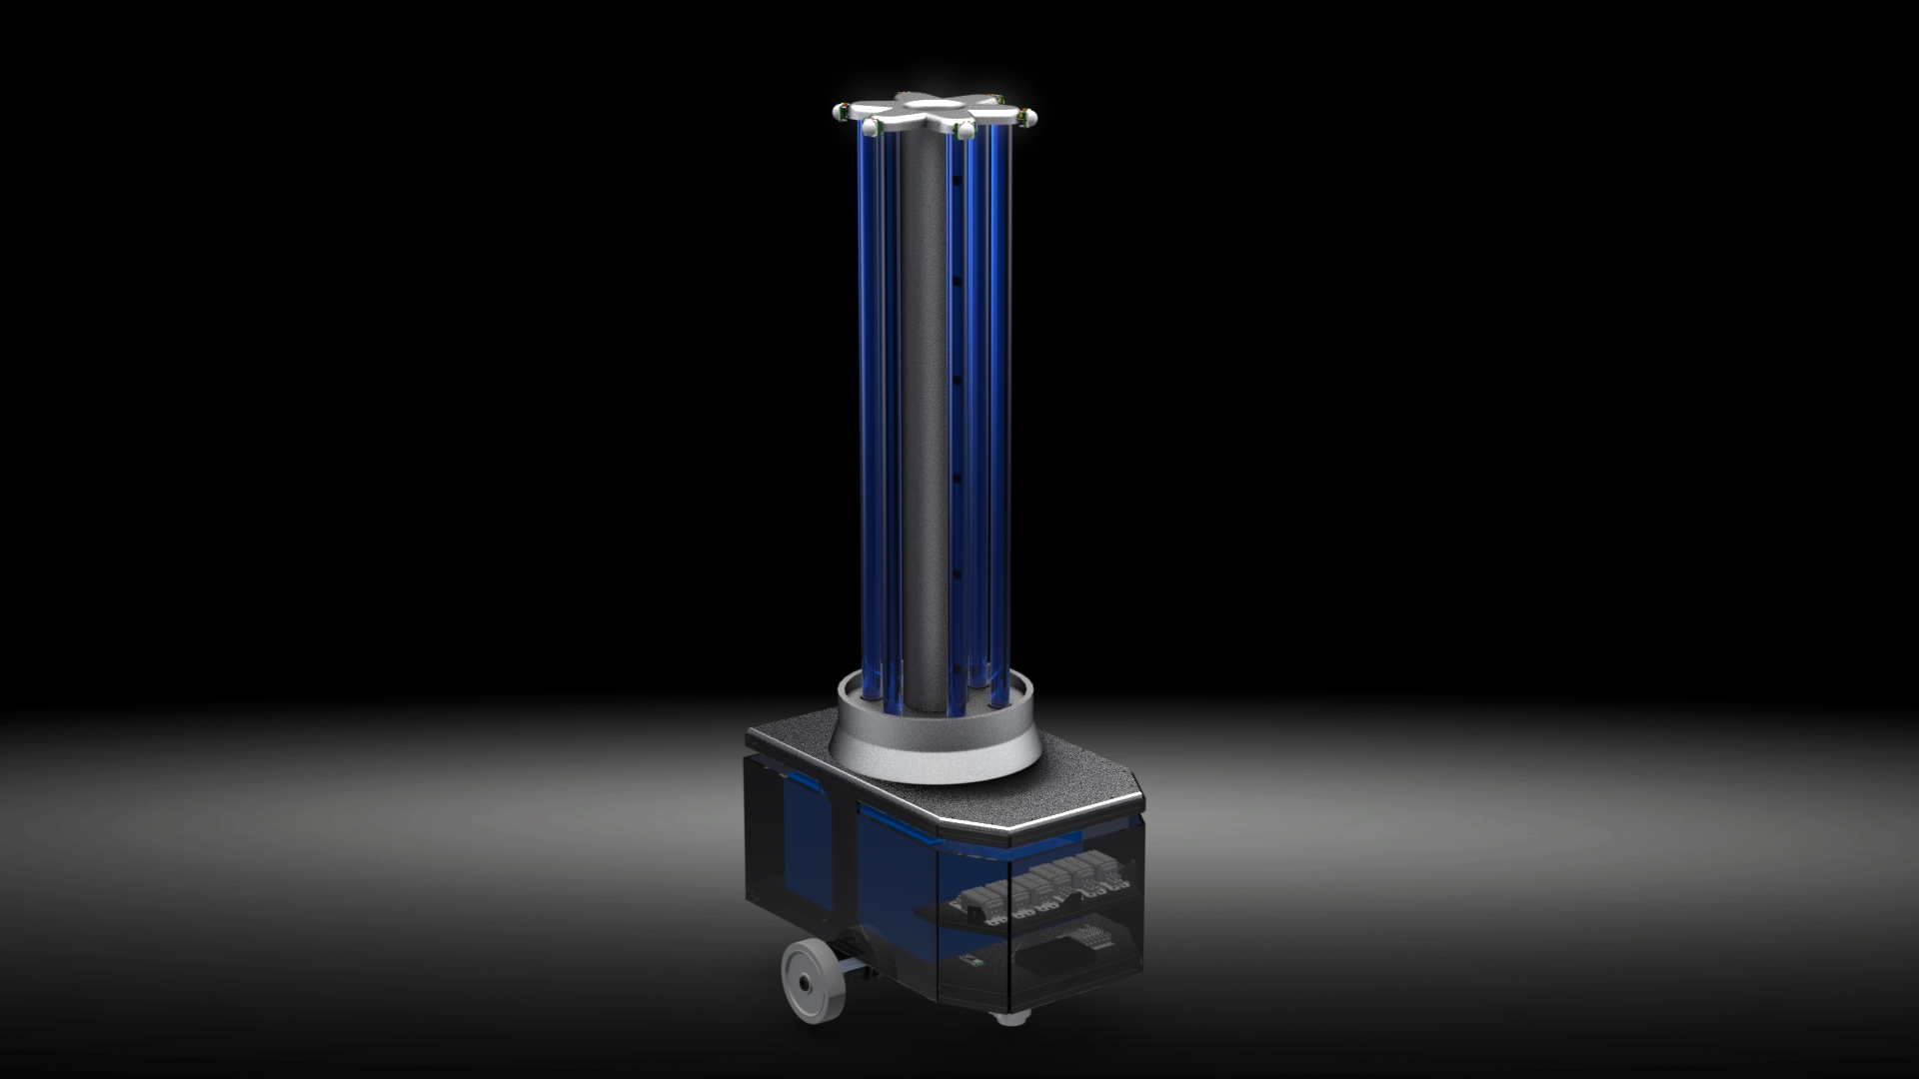
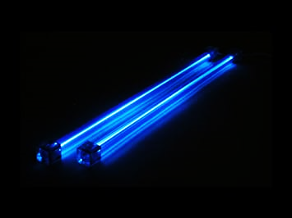
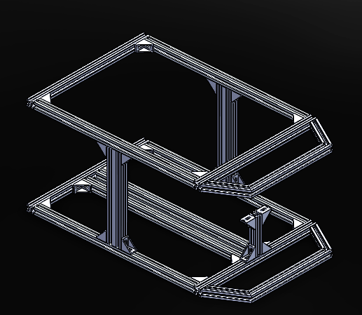

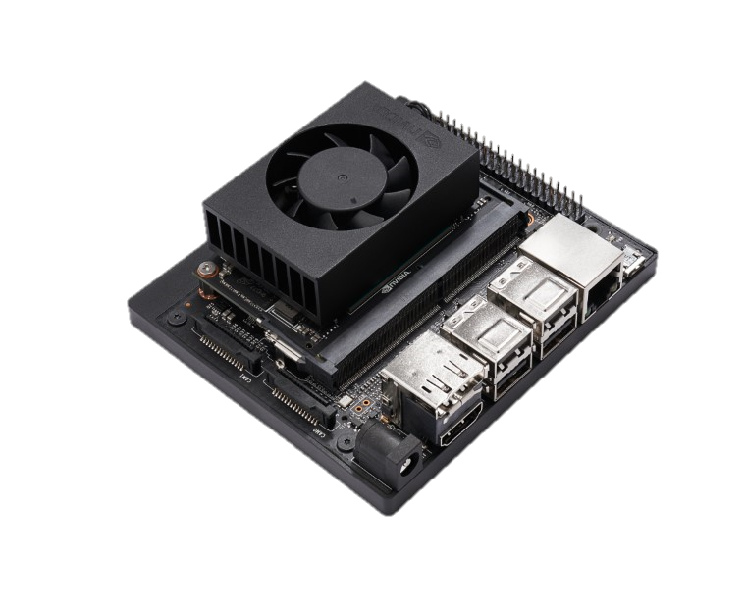
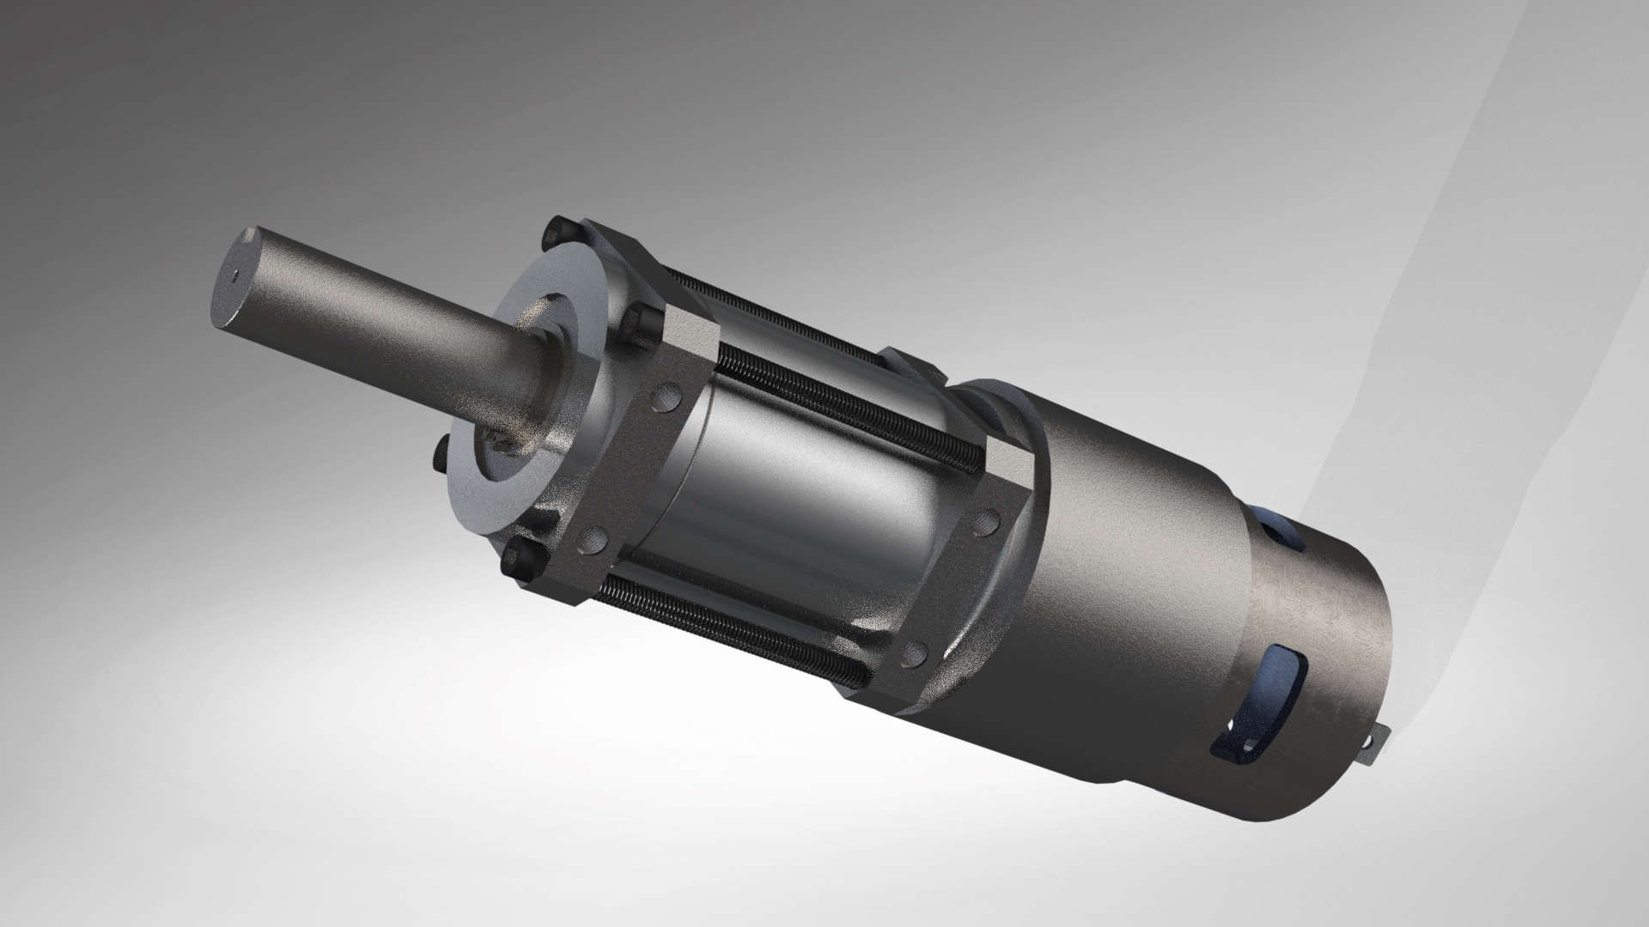
11.2W UV-C Lamps
Main Frame
Battery 1.3kWh
Nvidia Jetson
Motors
Notes:
All components used in the robot have been chosen after many rounds of deliberations. Alternatives were considered and the components most suitable for our needs were chosen. We followed this approach not only during the design but the placement of components as well. This ensured a tightly, yet neatly arranged and well integrated package that allowed us to achieve all of our design goals.
The upper body of the robot is adorned by 6 powerful UV lamps. Below their base, we have the high capacity battery arrange in the lowest possible position which helps in bringing down the centre of gravity of the robot. Below the battery, we have the electric motors and gearbox for driving the robot while still leaving enough clearance to comfortably travel over carpets. Just below the top deck, mounted upside down is the 2-D lidar. Mounted at the most optimum height, the LiDAR can capture most objects commonly found in offices. Down on the lower most deck, we have the very efficient yet powerful Nvidia Jetson Xavier for our computational needs. Encapsulating all these components is the lightweight aluminium main frame. I would like to highlight how we use only two beams on the side to support the lamps. This ensures that the LiDAR has an almost complete 360 degree view of the area.

Slide 5

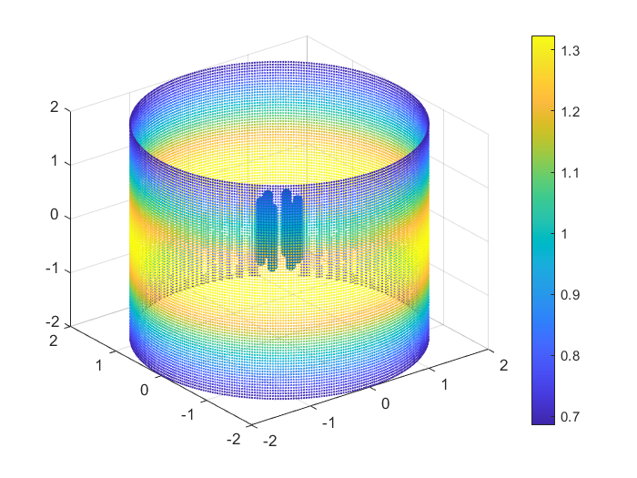

UV Lamps
A MATLAB program was coded to carry out calculation and provide a visual output of the irradiation pattern
This program can calculate the expected irradiance for multiple lamp configurations at various distances
We used this program to choose the wattage of our lamp model, their configuration and the time it will take to irradiate surfaces at various distances
Values indicated show the time it takes to disinfect surfaces at a height 2.4 meters above the ground with an irradiation dose of 25mJ
Power (W) | Distance (m) | Irradiance ($μ$W/cm²) | Time (sec) | Energy (Wh)
255 | 1 | 169 | 147.9 | 10.4
 | 2 | 85 | 294.1 | 20.8
 | 3 | 48 | 520.8 | 36.9
Notes:
Mukhar: Hello Everyone, from the outset our goal was to ensure that we are able to sanitise all surfaces without expending more energy then what is required. The UV lamps being used by us are 1.1 meter long cold cathode cylindrical tubes whose irradiance decreases as we move away from the mid point of the tube. To calculate the expected irradiance of the lamps we created our very own program based on the principals of photonics. This program is extremely flexible and allowed us to test lamps of different wattages, in multiple configurations at various distances.
With the help of this program, we were able to make confident design decisions regarding the capacity, number of UV lamps and the time required for sanitising surfaces. These values have been indicated in the table. We have decided to use 6 UV lamps with an input power of 34 Watt each. Taking 80% ballast efficiency, the combined wattage of these UV lights is 255 watts. Irradiance values indicated are for points that are 1.5 meters above or below the mid point of the UV lights while the points closer to the mid point receive more irradiance as we can see in this graph. Because the midpoint of the UV lights is already 0.9 meters above the ground, time indicated by us ensure that surfaces 2.4 meters high and 2 meters away receive a dosage of 25mJ within the time limit of 300 seconds. Users can additionally choose smaller or larger distances depending upon the size of the room for a more energy efficient operation.

Slide 6
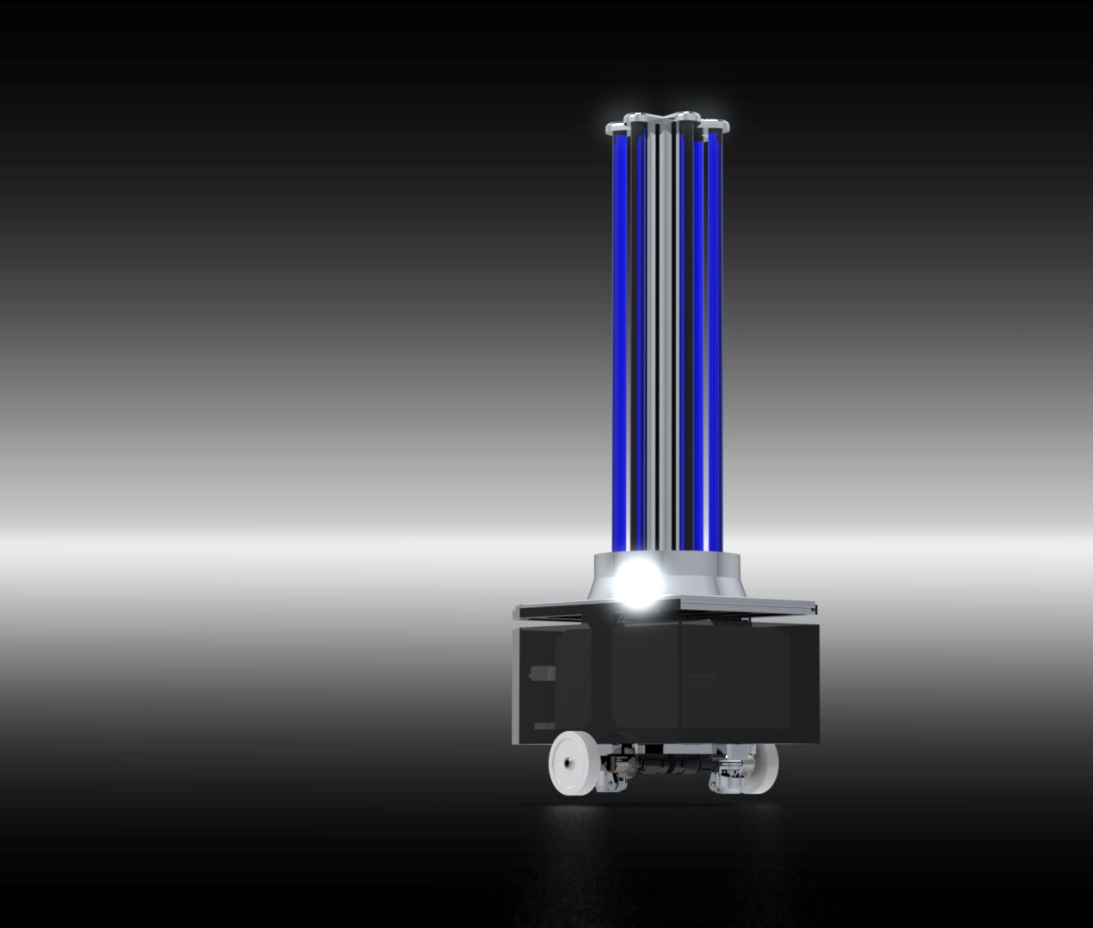
UV lamps
STER-L-RAY’s CC48T5L Cold Cathode 11.2-Watt UV lamp
6 UV lamps arranged uniformly in a circle
360-degree coverage
Germicidal UV-C with wavelength 254nm
Long life (20,000 hrs) and unaffected by frequent starting
Notes:
Gunsagar: Once we had determined the required luminous flux of the UV-C lamps, we had to make a choice between their underlying technology. We determined that the efficiency of both UV LEDs and Cold cathode lamps was about 30%. LEDs however, being a very new technology, had a very high price and would have required us to develop systems for keeping them cool. Between the cheaper traditional UV lamps and the Cold Cathode technologies, Cold cathode lamps were the obvious choice due to their high life cycle and resilience to frequent on-off cycles.
Ensuring quality, reliability and easy availability down the line; we decided to use Ster-L-Rays Cold Cathode lamps for our robot. These 11.2 Watt UV lamps operate in the far UV-C region (254nm) and are certified for germicidal applications. The 6 UV lights are arranged uniformly in a circle and provide complete 360-degree coverage. The lights chosen by us have a life of 20,000 hours and are unaffected by frequent power cycles.

Slide 7
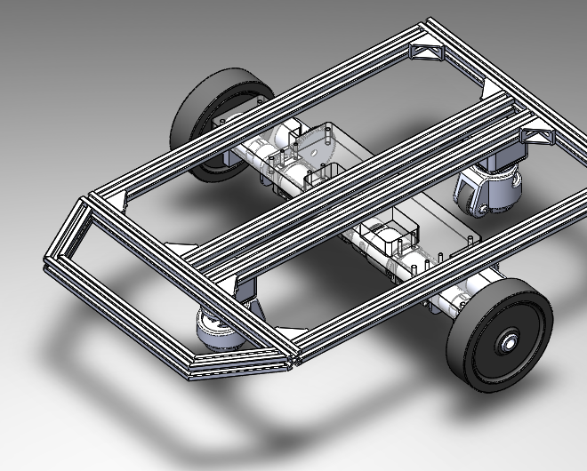
Drive System
Driving Wheel
Encoder
Why differential drive system?
Statistically Stable
Zero Turning Radius
Low Cost
Light Weight
Specifications
Achieves a speed of 1.4 m/s in 3 seconds
Can traverse a grade of 7.5°
Castor Wheel
Motor
Notes:
Rohan: Hi everyone. Coming to the drive system of the robot, we have chosen a 2-wheel differential drive. It has two independently operating wheels on either side of the robot which drives the robot forward & backward as well as perform turns of any radius. These wheels are coupled with rotary encoders which can detect the rate of rotation of wheels.
Additionally, two undriven castor wheels are mounted on the drive that gives stability to the system.
The chosen system is good for us because it meets our desired technical specifications and at the same time has advantages of being light weight and costs less than other options.
From our calculations, considering the chosen set of hardware, the robot can achieve a speed of 1.4m/s in 4 seconds, traversing a grade of 7.5degrees.

Slide 8
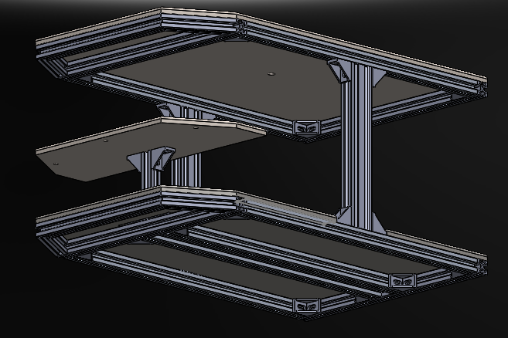
Mechanical Frame (Chassis)
Made from Aluminium Profiles
Aluminium Plates at each level to distribute the load
The chassis can bear a load of up to 60kg
Modular design ensures placement of components utilizing minimum volume
Specifications
Weight = 55Kg
Dimensions: 60cm x 37.2cm x 138.7cm
Tipping force: 70 N
BOM and part drawings are documented which provides the manufacturing route of the Robot
Notes:
Rohan: Next, talking about the frame of the robot, the structure is made up of light weight aluminum profiles. The chassis has 3 levels as seen in the image. Each level has a metallic plate on it, bearing the load present at that level.
Finally, the mechanical specs of the robot are as follows:
-
-
Which fall well within the maximum dimensions indicated in the competition

Slide 9
Outer body
Acrylic plates on all sides
Suitable for prototyping version
Single mould enclosure
Suitable for mass manufacturing
Design can be custom made
Notes:
Rohan: Coming to the outer body, we are presenting two options. First- Using acrylic plates: Multiple acrylic plates are joined together to cover the robot. This choice is suitable for prototyping as well as for small scale manufacturing.
If we consider mass manufacturing, then the 2nd option which is a single mold enclosure would be better and cheaper to manufacture. Also, it gives flexibility in designing the shell and finally gives a better look

Slide 10
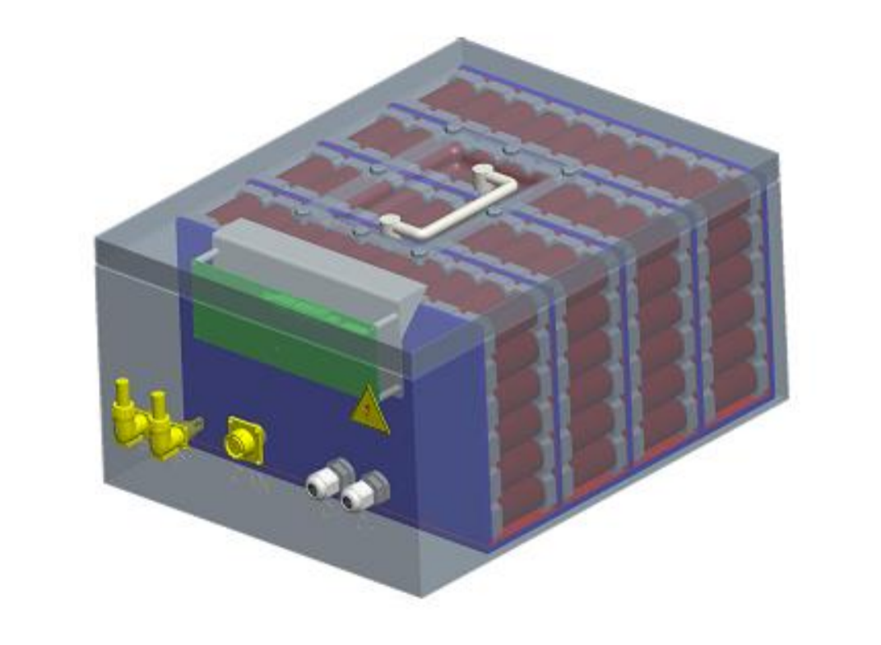
Power Source
1.3 kWh 25.6 Volt LiFePO4 battery manufactured by UltraLife Corporation
Safest Lithium-ion based battery chemistry
Long life with 2000+ charge cycles
Inbuilt Battery Management System for safe operation
CAN communication for reporting battery health and state of charge
Enclosed in a fireproof ABS enclosure
Notes:
Shantnav: Powering our robot is a 1.3 kWh battery manufactured by the Indian subsidiary of UltraLife Corporation. We went with Lithium Ferrous Phosphate battery chemistry due to it’s high power density while being the safest lithium-ion based technology. This chemistry also has an extremely long life.
The battery pack has an integrated battery management system for cell charging and balancing. The BMS also features a CAN communication system that shall connect with the Jetson Xavier and provide information about the state of charge as well as the health of the battery.

Slide 11
Energy Requirement Calculations
# | ROOM TYPE | DIMENSIONS (m) | AREA (sqm) | # OF 1m CIRCLE | # OF 2m CIRCLE | TOTAL ENERGY (Wh) | T.E. PER sqm
1 | Office | 4 by 4 | 16 | 4 | 1 | 62.75 | 3.92
2 | Office | 3 by 4 | 12 | 2 | 1 | 41.79 | 3.48
3 | Lab | 6.1 by 5.8 | 35.38 | 0 | 5 | 104.17 | 2.94
4 | Operating Room | 7.1 by 8.7 | 61.77 | 0 | 9 | 187.50 | 3.04
5 | Floor plan of a building | 17 by 11 | 184 | 0 | 22 | 458.33 | 2.49
 |  |  |  |  | Average | 170.91 | 3.17
0.11Wh energy consumed by drive system per meter of travel
Can cover 250 sqm / 12 rooms on a single charge
Worst Case Scenario: 50 sqm of area covered with 70% overlap with a runtime of 3 hours
Notes:
We extensively studied various floor plans of buildings to estimate the amount of energy it will take for sanitisation. Based on numerous data points, we deduced that it would take about 3 Wh of energy to sanitise 1 sqm of area. Based on theoretical calculations, we have ascertained that the drivetrain shall require 0.11Wh of energy to travel 1 meter of distance. Based on these values, we estimate that the robot should comfortably cover an area of 250 sqm which is equivalent to covering 12 large rooms.

Slide 12
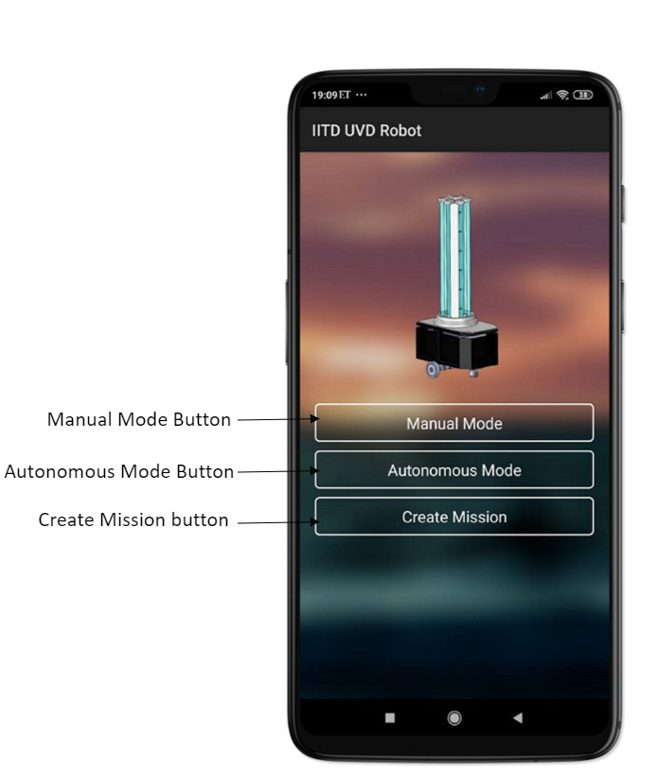
Android Application
Notes:
Hello everyone, I am very excited to showcase our android application and demonstrate how easy it is to use our product. The robot connects to the android application easily via WiFi. Within the application, the user can personalise the robot by giving it a name as well as interact with it. There are three main windows within the application – The manual mode, autonomous mode and the creation of missions mode.
Apart from this, the app shall be used to keep track off the on/off cycles of the UV light as well as the amount of hours they have been switched on for.

Slide 13
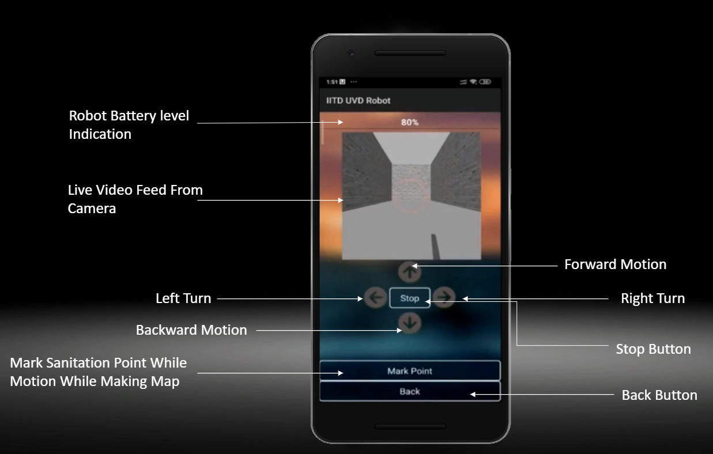
Manual Mode
Map created by driving robot using the app
Sanitation point selection done while mapping or after the map is made
Notes:
Let me begin by talking about the Manual mode. In this mode the user can start the creation of a map of a floor in the building. Using the joystick within the app, the robot can be driven manually by the user. He shall see a live feed from the onboard camera as well as the current battery level of the robot. As per convenience, the user can also mark the current position of the robot as a sanitation point that can be later integrated into a particular mission. This process needs to be carried out once during the initial setup of the robot.

Slide 14
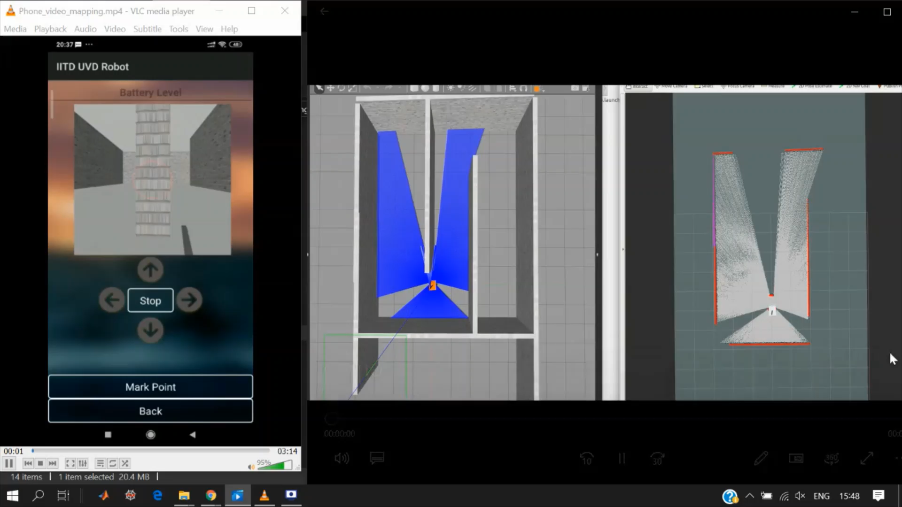
Initial Mapping
Notes:
Here we demonstrate this functionality by driving a robot being simulated in Gazebo, a popular simulation platform for robotics applications. The window in the middle is the top down view of the simulation while the window on the left shows the screen of the application. The blue rays in the middle window show the LiDAR rays that are being used to create the map by the robot.
The window on the right shows the process of creating the map that is done by the robot internally. Once the mapping is complete, the user can name this map and save it.

Slide 15
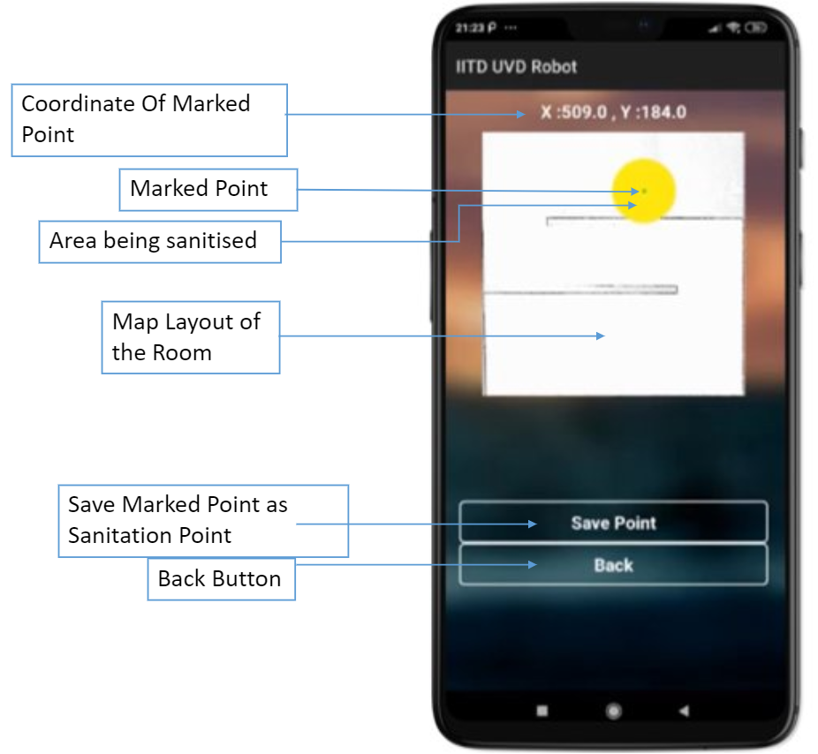
Creating Missions
Create and save multiple missions within the app
Add sanitation points by merely touching the location on the picture of the mapped area
See the sanitised area and set the desired sanitation distance
Notes:
Once the map is created, the user can create multiple missions for that map. While creating the mission, the user shall see a picture of the map that was saved in the manual mode. From here the user has to merely touch various locations on the map and choose them as sanitisation points. While touching these points, user can see the area that will be sanitised in yellow colour and increase or decrease the sanitisation area as required. Once the user has chosen all the points for that mission, he can save it. These saved missions can then be executed from the autonomous mode whenever required

Slide 16
While Starting Mission
Determine most efficient path (TSP)
Calculate energy requirements
Determine time to completion
User notification and confirmation
Notes:
While starting the mission, the onboard computer begins by calculating the most efficient path to all the sanitation points based on it’s current location. After that, it calculates the energy requirements and checks if enough charge is present. If charge is insufficient, robot will drop a few points from the mission and propose the new plan to the user.
The robot shall also determine the time it will take to complete the mission. This shall be communicated to the user who can then give the final confirmation for starting the mission.

Slide 17
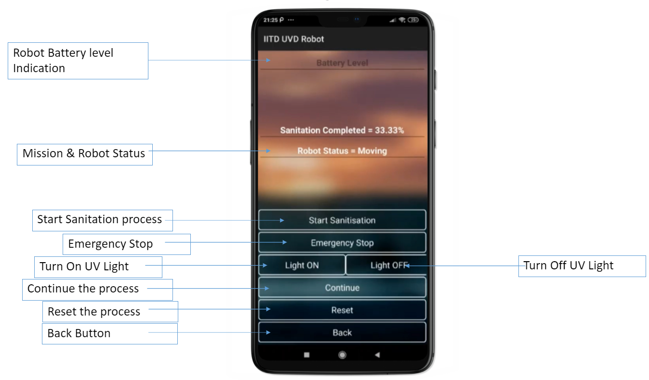
During Missions
See the location and a live camera feed of the robot
Easily keep track of the robot including battery level, time remaining in sanitation during current mission
Receive notifications whenever the mission is interrupted due to any safety event
Control robot movement and UV lights easily
Notes:
Once the mission is in progress, this screen is shown to the user. Here all important information regarding the current state of the robot and progress of the mission is shown to the user. User may also control the lights of the robot or bring it to an emergency stop. If any safety related event happens during the mission, the robot via the android app can notify the user immediately.

Slide 18
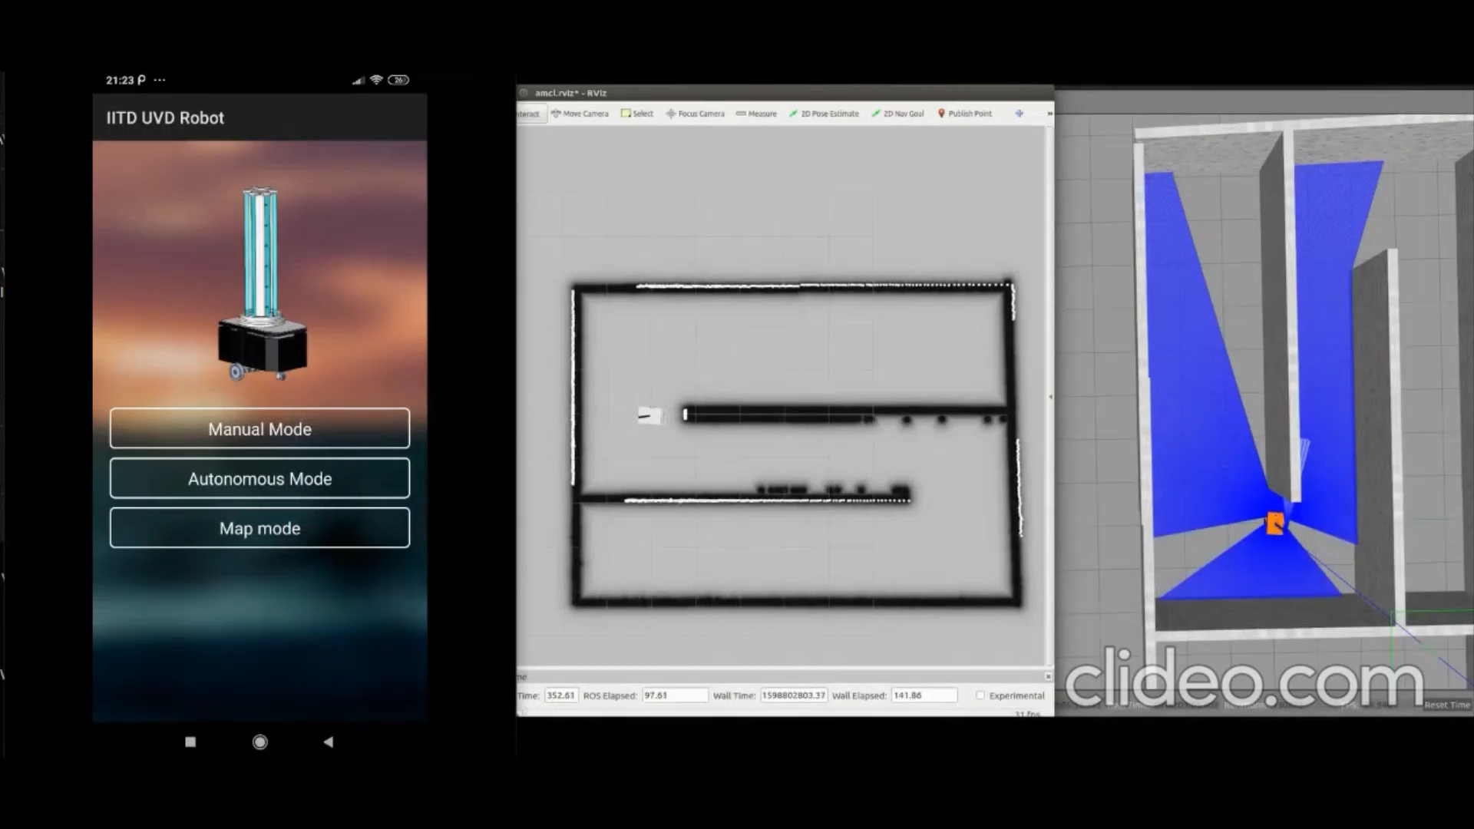
Mission Demo
Notes:
A Full sanitization mission of a map is shown in this demonstration. From the apps main Menu we select the create missions mode, showing us the previously crated map. Points which are to be sanitised can be interactively selected by the user and saved. When an individual point is selected we can also see the real area in yellow where the robot will sanitize. Once the points are saved we go to the autonomous mode and start the mission.
The robot moves autonomously from its current position to the point marked on the map. The Android app also gives real time status of the robot as well as of the sanitization process.
Once the robot reaches a way point it starts to sanitize that place. The progress of the mission can be seen on the app as well.
Finally when the bot has completed all the way points we can see the status shows 100% completion and the robot shall return to it’s docking station.

Slide 19
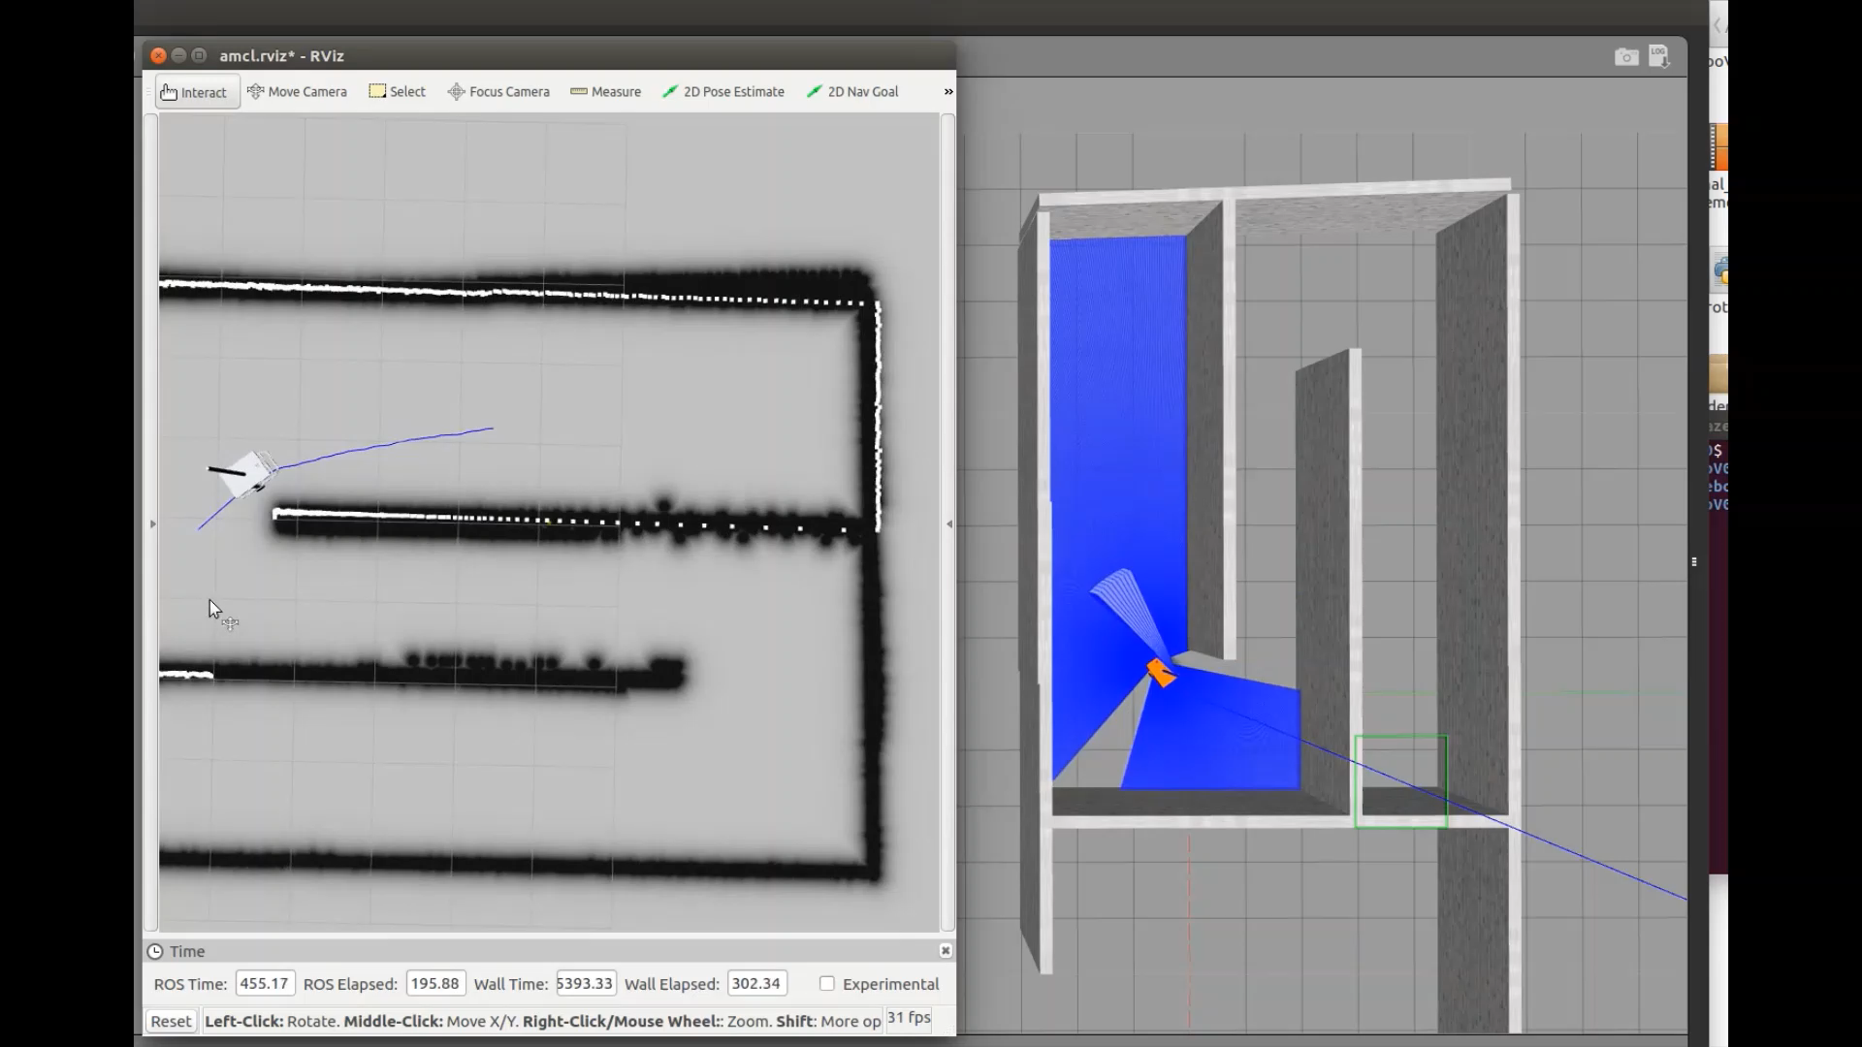
Emergency Stop
Notes:
The emergency stop button ensures that the user is always in control. On the tap of a button, the user can immediately bring the robot to a complete halt. If the lights are turned on, pressing this button will switch them off!
Once the situation is resolved, the user can easily allow the robot to continue from where it left off. This makes the operation of the robot extremely safe and hassle free!

Slide 20
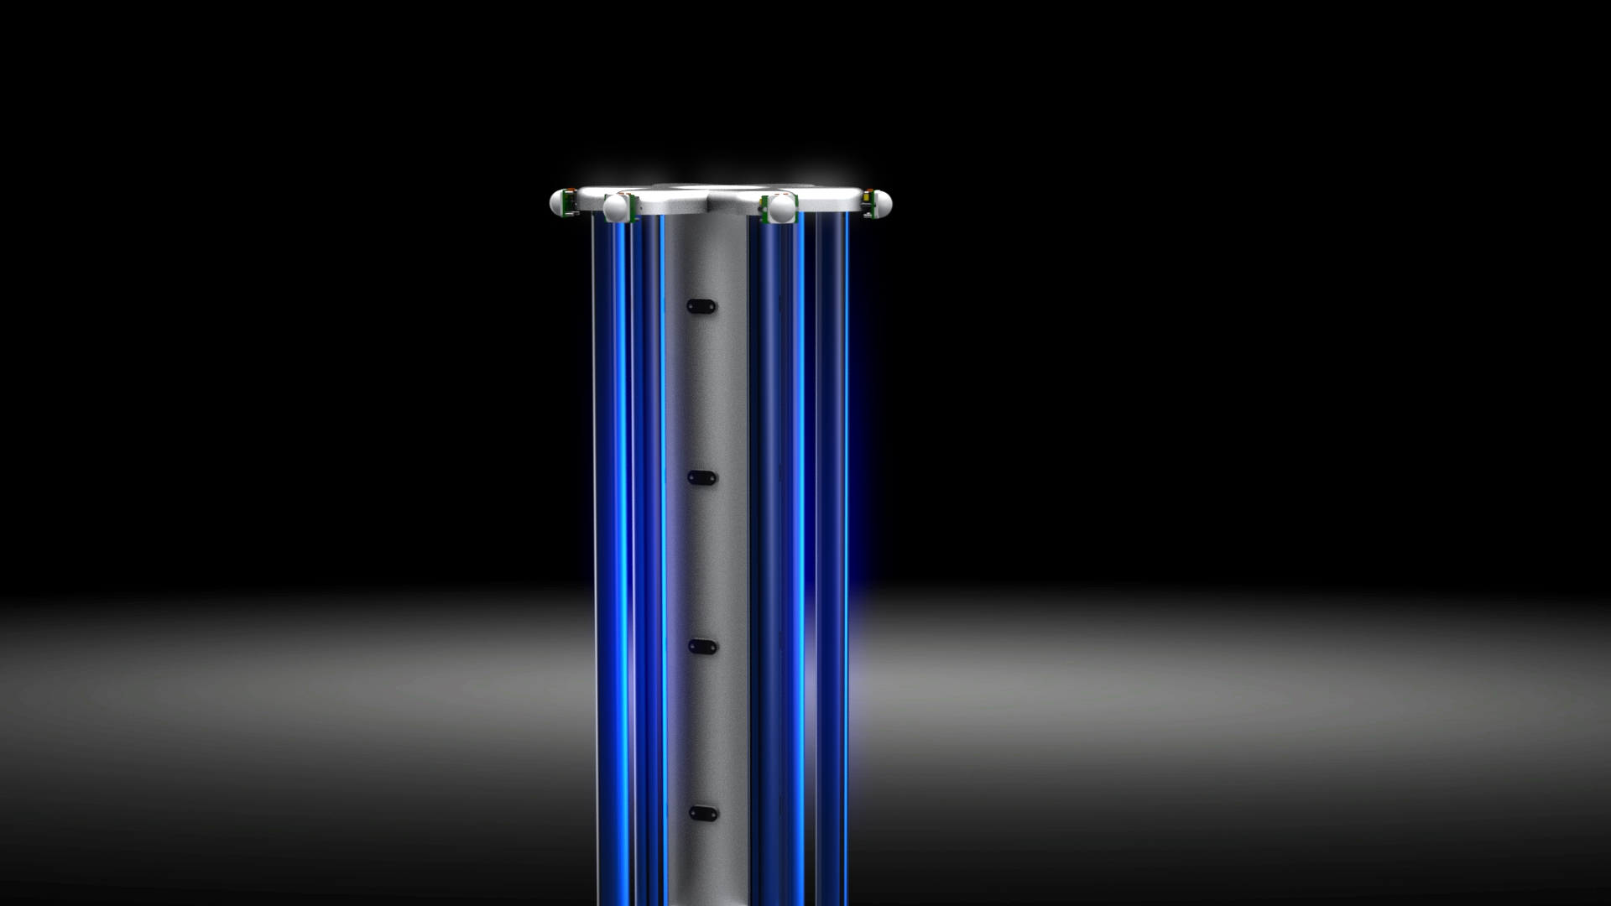
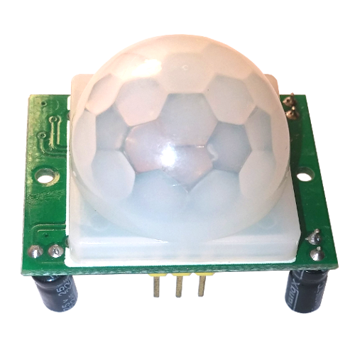

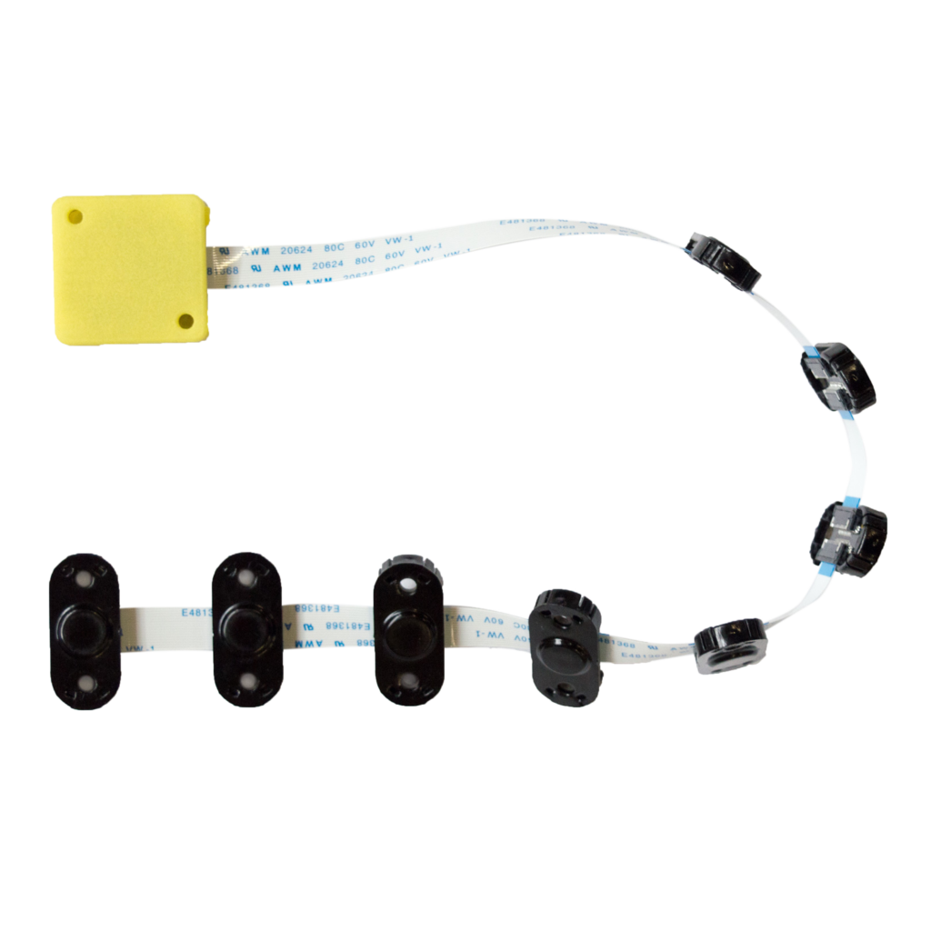

Safety Features
Infrared based human detection with range up to 7 meters
ML based voice enabled control for emergency stop
Multiple ToF sensors for object detection along the height of the robot (TeraRanger by Terabee)
Wireless communication with android app
Notes:
UV technology is extremely dangerous and it is essential to use it with as many precautions as possible. Therefore, we have taken a multi-tier approach to safety.
The UV lamps are turned on only when the robot is stationary. Each UV lamp is covered within a safety shield which shall protect humans from exposure to mercury as well as broken quartz in the unlikely event of an accident.
We use multiple infrared based sensors to detect the presence of humans. This is a proven technology commonly used in automatic lights and can detect humans up to 7 meters away.
Unique to our robot For detecting obstacles, we are using multiple Time of Flight sensors that have been fitted across the height of the robot. These sensors work in coordination with each other to detect obstacles up to 2 meters away. They can detect obstacles along the entire height and width of the robot. These sensors can detect all kinds of obstacles including glass tables, cabinets, chairs and prevent a collision with them. By using these sensors in conjunction with a 2D LiDAR we did not need an expensive 3D LiDAR.
Another feature of our robot is a machine learning based voice enabled emergency stop system.

Slide 21

Voice Based Safety Feature
Introducing a voice-based command system to stop the robot while disinfecting
Extensive and open source Google Speech Commands Dataset used for reliability
Trained for words: STOP, NO, OFF
Capable of distinguishing between background noises thereby reducing false positives
Detection accuracy of 88%
Notes:
Neelabh: Hi everyone, Doubling down on safety, at anytime during the operation of the robot; any person can simply shout words such as Stop, Off or No in order to stop the robot. Doing so will immediately bring the robot to a complete halt and turn off its UV lights. Additionally, the robot will instantly send a notification to the android app notifying the user of this event.
The machine learning model itself has been trained on a large, extensive, and opensource Dataset, called the google speech commands dataset. The words OFF, STOP etc have been trained against thousands of other word occurrences, comprising of different accents, variations, words spoken in different intensities, etc. The dataset also covers sounds recorded over a large array of microphone, that may vary in quality. Interestingly, it has even been trained against normal noises such as that of an office, so as to lower down the probability of false positives.
As a result we have been able to reach a detection accuracy of 88% for the wake words.
Implementing this feature by leveraging cutting edge technologies adds a whole new dimension of safety to our robot
Now please allow Dhruv to guide you further ahead.

Slide 22
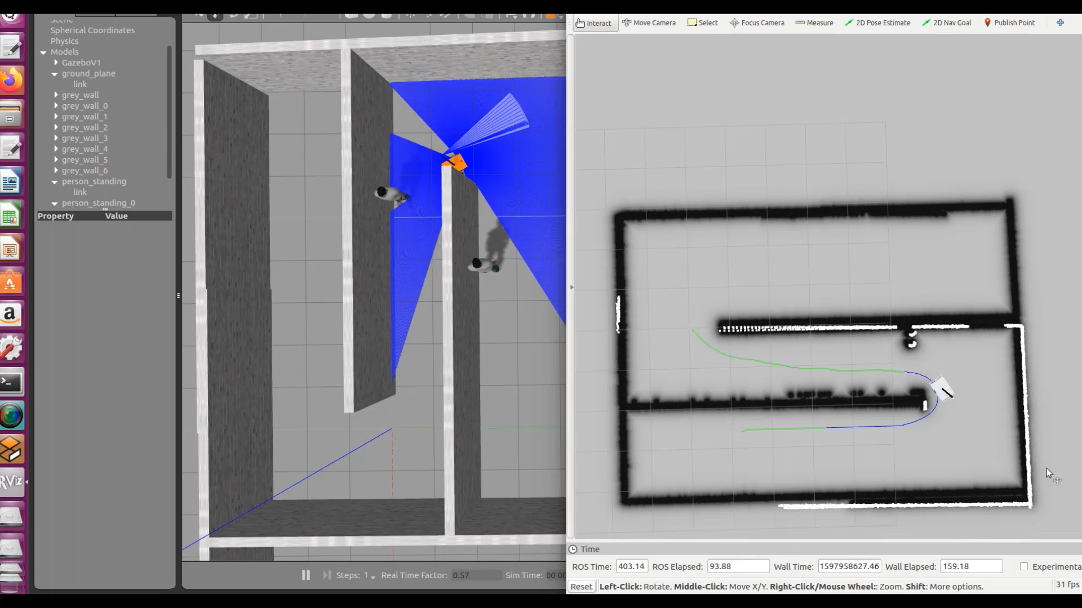
Obstacle Avoidance
Notes:
Shantnav: The robot can autonomously reroute in the case it encounter’s an object along it’s path. We demonstrate this by adding two stationary humans to the map as shown in the simulation window on the left. During the initial planning, shown as the green route, the robot only see’s the human on the left and routes away from it. However on seeing the second human in its path, the robot is dynamically able to reroute and continue with it’s mission

Slide 23

Software Stack
Robot driven via the ROS differential drive controller​
ROS packages by Terabee used for obstacle detection​
Robot navigates and avoids obstacles via the ros navigation stack​
Localisation within the building using LiDAR scanner
Notes:
Shantnav: All scenarios demonstrated above are logics that have been created by us for the autonomous operation of the robot. These logics have been created on top of Robot Operating System. Robot operating system or ROS is an open source meta operating system that provides access to numerous open source libraries for robotics applications. It also severs as a backbone for the entire process by managing various processes and transmitting messages between them. Packages in ROS are extremely reliable and have been thoroughly tested on real world robotics applications.
We make use of the ROS differential drive controller to ensure that the robot follows the path it is supposed to. Further we use ROS packages provided by Terabee, the manufacturer of the Time of Flight sensors, for fusing data from multiple sensors and detecting obstacles in the path of the robot.
We use the popular Adaptive Monte carlo localisation algorithm on the LiDAR data to localise the robot within the building
The navigation of robot within the building and around obstacles is taken care of by the ros navigation stack.

Slide 24
Bill of Materials
# | Item | Price ($)
1 | Nvidia Xavier NX | 399
2 | Battery + Power Supply | 1500
3 | Chassis | 145
4 | RP LiDAR A3 | 599
5 | TeraRanger Multiflex | 115
6 | PIR HC-SR501 | 10
7 | UV Light holder | 69
8 | UV Light ballast | 660
9 | UV Light Lamp | 690
10 | Banebot DC Motors | 35
11 | Gearbox- P61 16:1 | 92
12 | Optical Rotary encoder 2500ppr | 108
13 | RoboClaw 2x30A Motor Controller | 125
14 | Wi-60 Auto Castor Wheels | 30
15 | Colson Wheel | 7
16 | Colson Series 2 Hub | 14
17 | SSR-40DA Solid State Relay Module | 7
18 | Arduino Nano 33 BLE Sense Header | 34
19 | Raspberry Pi Camera Module V2 | 35
20 | Speaker | 4
21 | Fast LED WS2812B | 4
 | Total | 4682
Notes:
Shantnav: I would now like to quickly go over all the components that have been used in the robot. The brain of the robot is the Nvidia Xavier NX. Most sensors such as the LiDAR and TeraRanger connect to it. It interacts with the android application over wifi. The battery installed in the robot is a made to order design making it the single most expensive component of the robot. If we go for mass manufacturing, then a volume order of the battery will bring the cost down. We are using the RP LiDAR A3 along with Terabee’s TeraRanger multiplex for the navigation of the robot. These sensors work in tandem to eliminate the need of a 3D lidar helping us not only save on computational cost but also on actual cost of the robot.
PIR sensors are being used to detect the presence of humans.
The next 3 items on the list are components related to the assembly of UV lights.
Items 10 to 13 make up our drive system with the rotary encoder acting as a feedback sensor for ensuring reliable movement of the robot along the desired path.
Item 17, the solid state relay is being used to turn on or turn off UV lights. The Arduino Nano 33 is a sort of co processor taking care of the safety functions of the robot. The ML model described runs on it while the PIR sensors also connect with it. The nano finally controls the UV lights via the solid state relay.
We shall use coloured Fast LEDs to indicate when the UV lights turn on or off and shall also use the speaker to sound the alarm.

Slide 25
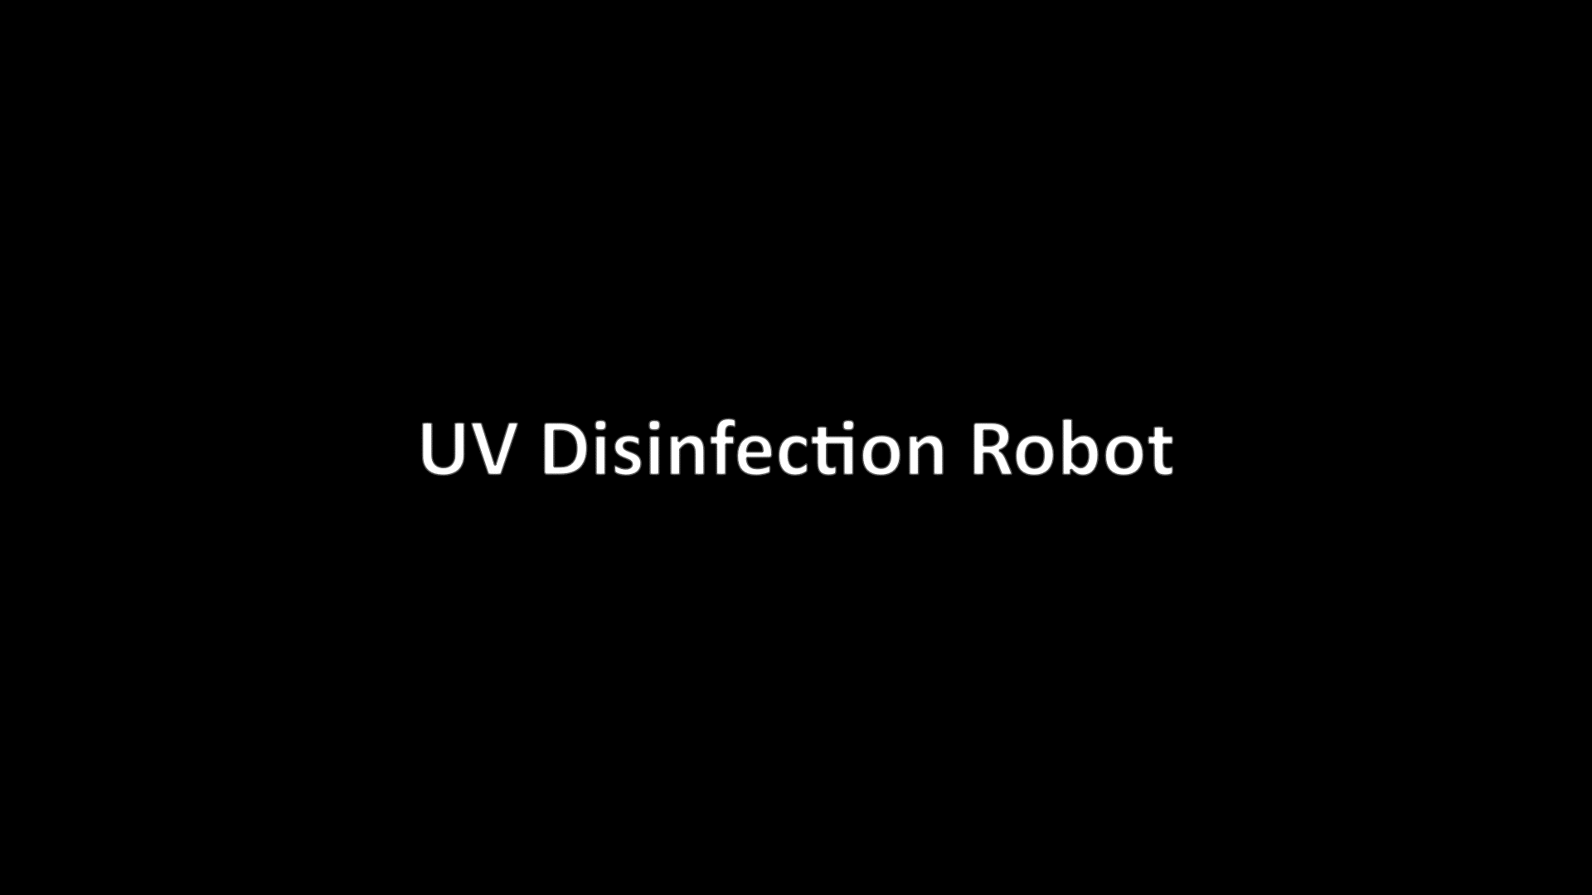
Video Demo of product Design

Slide 26
Summary
Elegant & Modern design
Sanitise 12 large rooms on a single charge
Intuitive control via Android app
Multi-tiered safety system
Open-Source Backend
Notes:
So this concludes our presentation. We would like to now open the floor for questions …

